Slide 1

Pixel

Slide 2
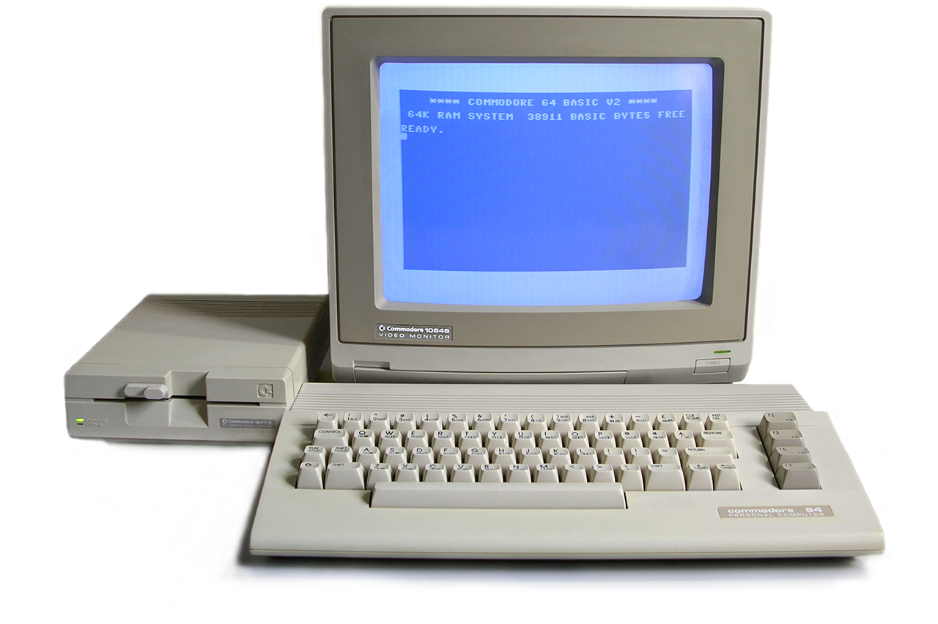
By Bill Bertram - Own work, CC BY-SA 2.5, https://commons.wikimedia.org/w/index.php?curid=133083

Slide 3
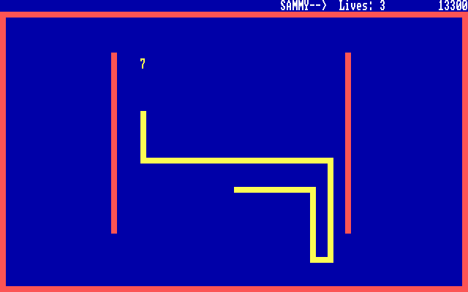

Slide 4


Slide 5
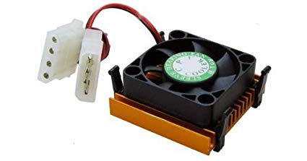


Slide 6
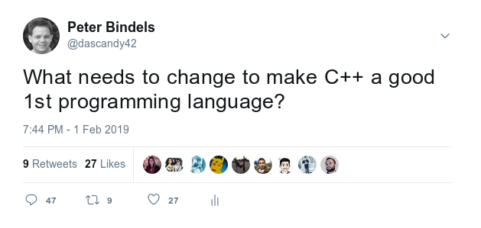

Slide 7
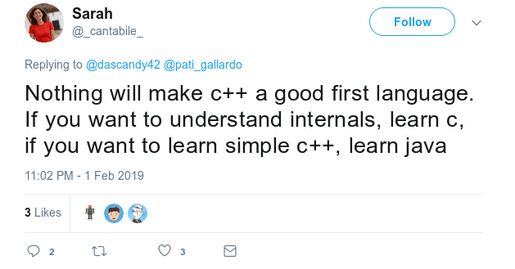

Slide 8
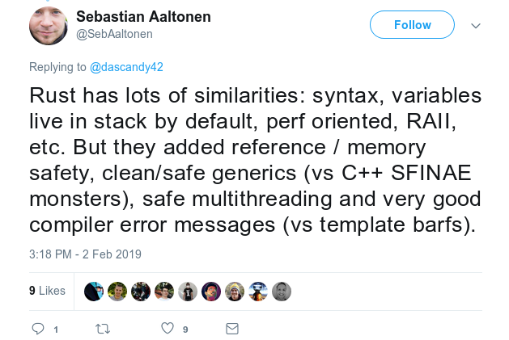

Slide 9
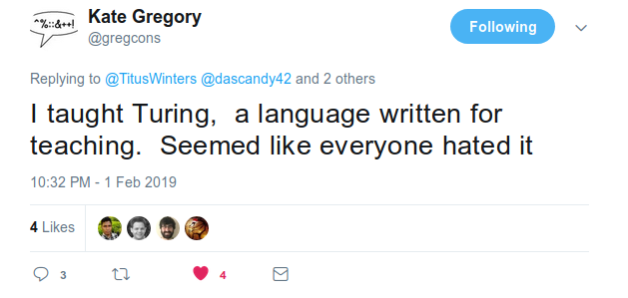

Slide 10
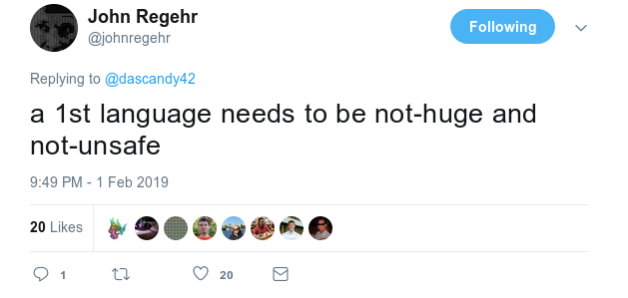

Slide 11
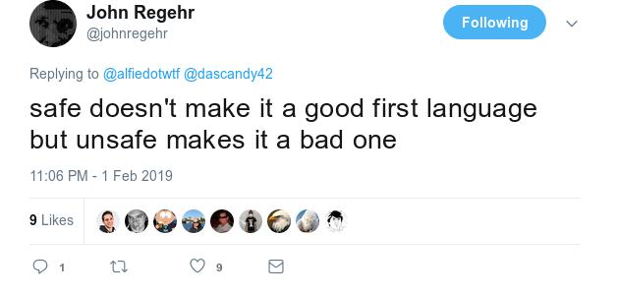

Slide 12
Summarizing
Use
  Rust
  C
  Java
  Processing
  Turing
  …
instead

Slide 13
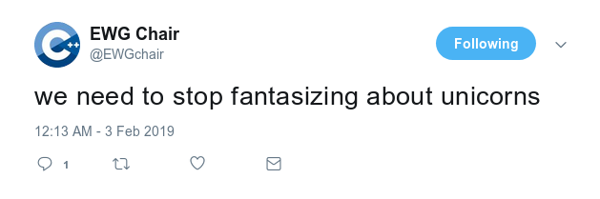

Slide 14
When Hell freezes over

Slide 15


Slide 16
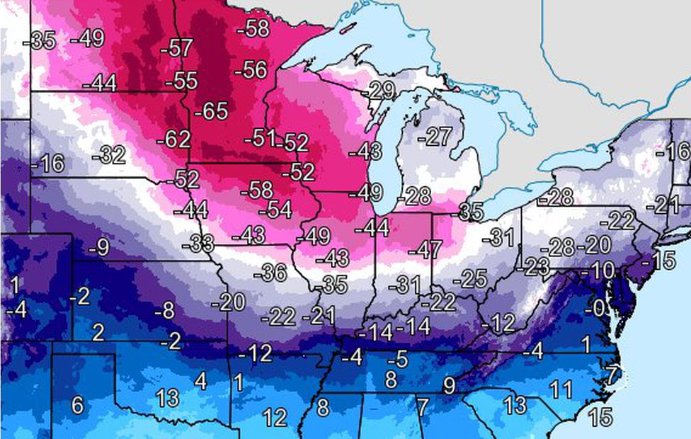

Slide 17
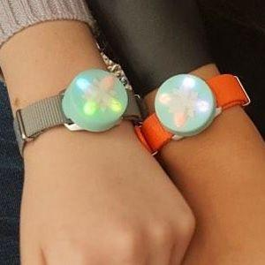
Jewelbots

Slide 18
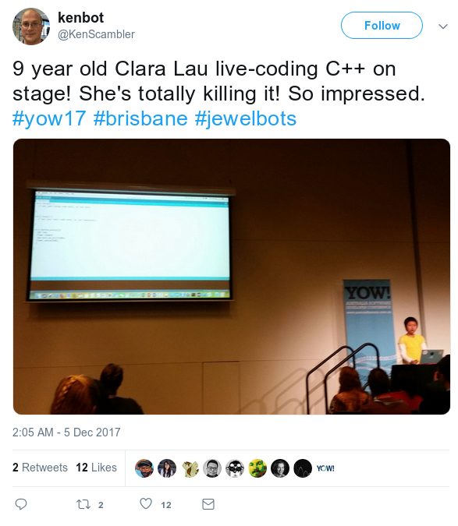

Slide 19
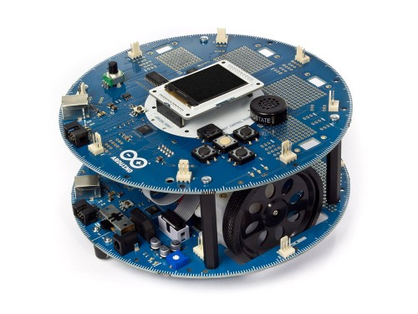

Slide 20
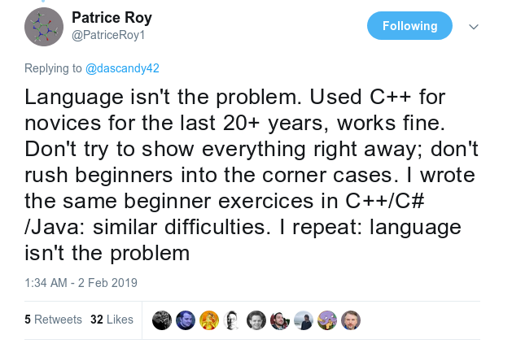

Slide 21
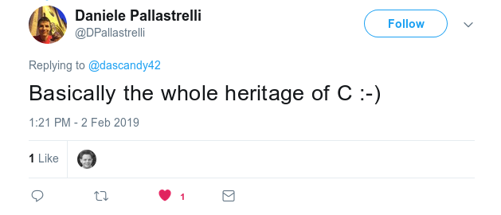

Slide 22
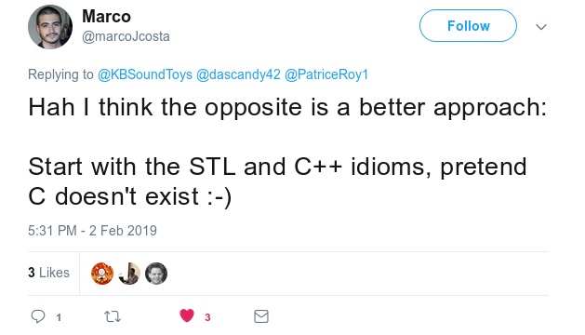

Slide 23
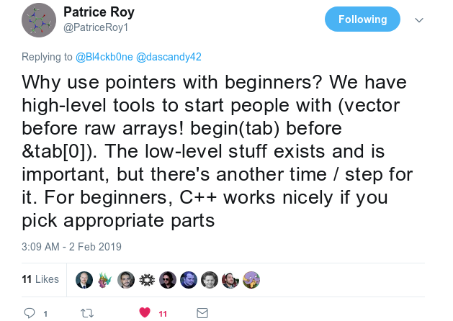

Slide 24
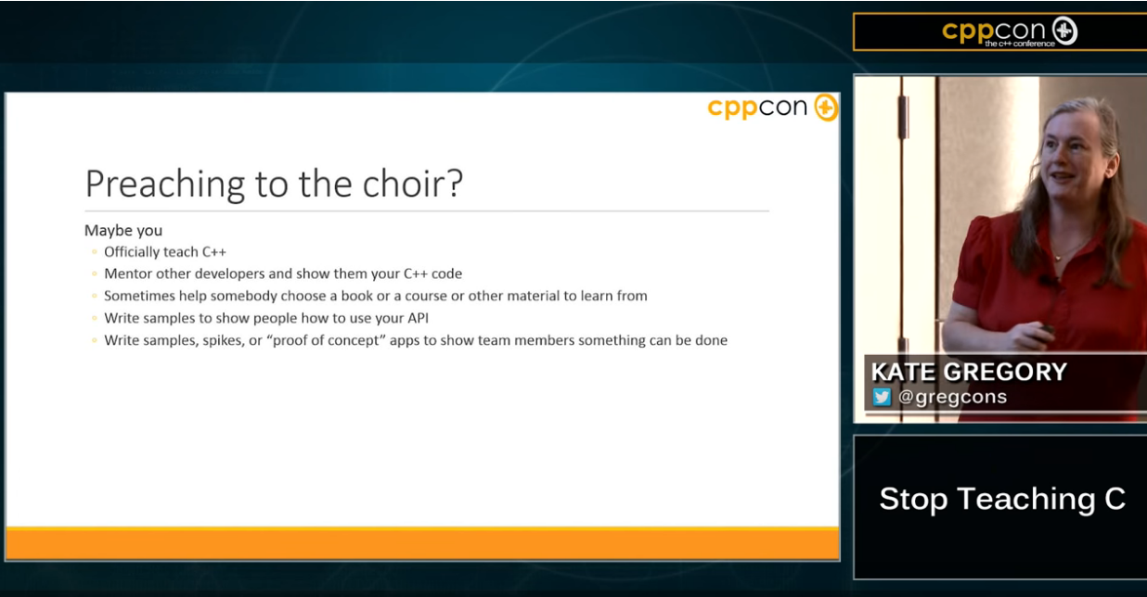
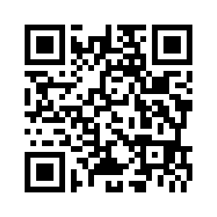
Stop teaching C – Kate Gregory @ CppCon 2015

Slide 25
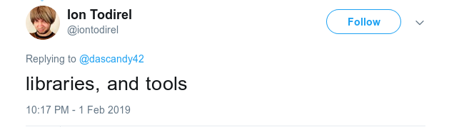

Slide 26
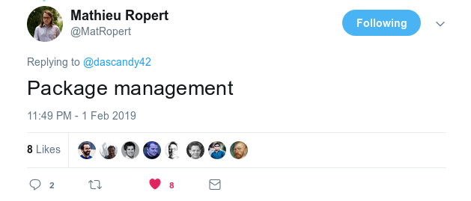

Slide 27
Stop teaching C – Kate Gregory @ CppCon 2015
Have good tools available for novices & experts
  Build tool
  Package management
  IDE

Slide 28
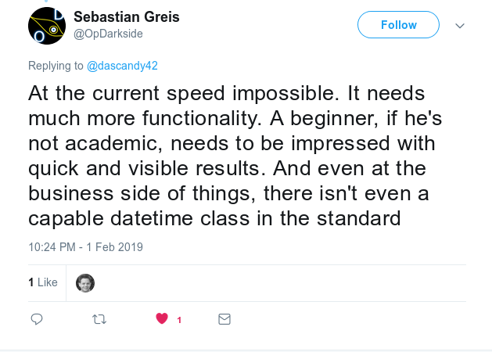

Slide 29
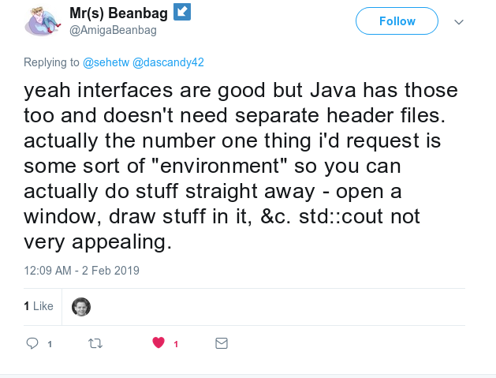

Slide 30
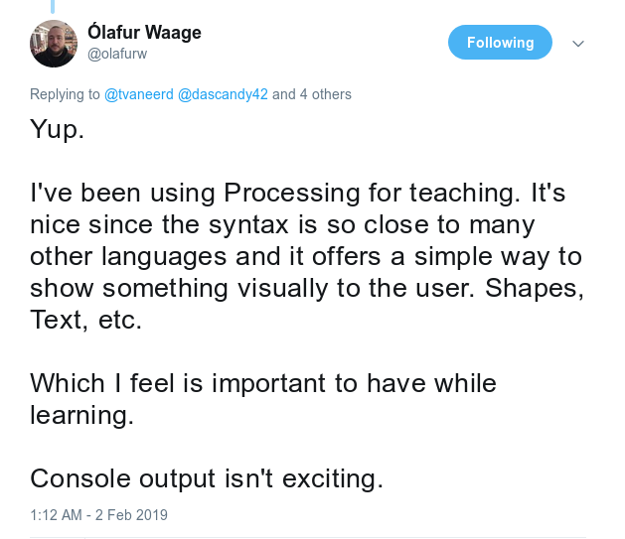

Slide 31
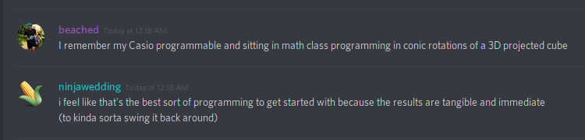

Slide 32
Stop teaching C – Kate Gregory @ CppCon 2015
Have good tools available for novices & experts
  Build tool
  Package management
  IDE
Give beginners quick results

Slide 33
Evoke – Pixel – Accio
Evoke: Build system with no configuration
Pixel: Simple 2D Graphics for quick results / easy intro
Accio: Functional and usable package manager
Get from zero to working game in a minute

Slide 34

Why Evoke
Build systems are hard
Time spent in one feels like manual duplication
Let’s try without
CppCon 2018

Slide 35

Why Pixel
Prior experience with OpenGL and graphics
Existing 2D Graphics proposal from BSI
It can’t be that hard?
Jayesh Badwaik

Slide 36
Why Accio
Can’t find a good and universal package manager
Needs package lookup by file name
I hope somebody else makes one before I get around to it.
If not, look out for it in late 2019 / early 2020.

Slide 37
Evoke – Pixel – Accio
Simple for simple cases
Powerful enough for the most complicated cases
  Sanity is applied
  Only if possible without making it harder to do simple things

Slide 38
Why not use...
CMake
Make
Meson
SDL
SFML
GLFW
Conan
Vcpkg
Apt

Slide 39
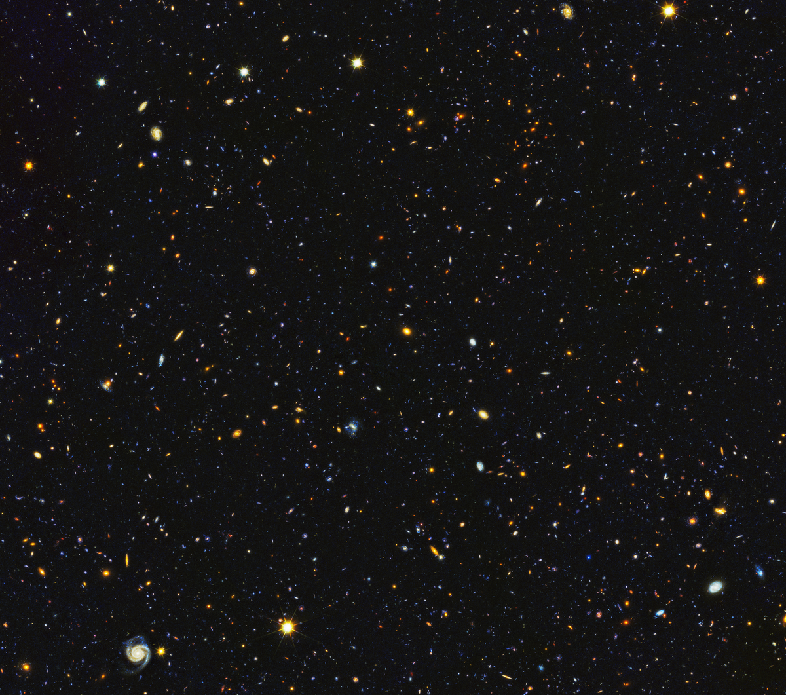
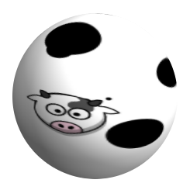

Slide 40
Simple
4a : lacking in knowledge or expertise
  a simple amateur of the arts
5b : free of secondary complications
  a simple vitamin deficiency
5c(1) : having only one main clause and no subordinate clauses
  a simple sentence
(2) of a subject or predicate : having no modifiers, complements, or objects
5d : constituting a basic element : fundamental
5e : not made up of many like units
  a simple eye

Slide 41
Simple
6 : free from elaboration or figuration
  simple harmony
7a(1) : not subdivided into branches or leaflets
  a simple stem
  a simple leaf
9 : readily understood or performed
  simple directions
  the adjustment was simple to make

Slide 42
Intuitive
1a : known or perceived by intuition : directly apprehended
  had an intuitive awareness of his sister's feelings
1b : knowable by intuition
  intuitive truths
1c : based on or agreeing with intuition
  intuitive responses
  makes intuitive sense
1d : readily learned or understood
  software with an intuitive interface

Slide 43
Intuition
In more-recent psychology, intuition can encompass the ability to know valid solutions to problems and decision making. For example, the recognition primed decision (RPD) model explains how people can make relatively fast decisions without having to compare options. Gary Klein found that under time pressure, high stakes, and changing parameters, experts used their base of experience to identify similar situations and intuitively choose feasible solutions. Thus, the RPD model is a blend of intuition and analysis. The intuition is the pattern-matching process that quickly suggests feasible courses of action. The analysis is the mental simulation, a conscious and deliberate review of the courses of action.
https://en.wikipedia.org/wiki/Intuition

Slide 44
C++ from nothing
Basic procedural flow (goes from top to bottom non-stop)
“Things” and lifetime
Function calls
While loop
If statement
Creating functions

Slide 45
Basic procedural flow
Empty program
Remember, we don’t know loops, function calls or lifetimes yet.

Slide 46
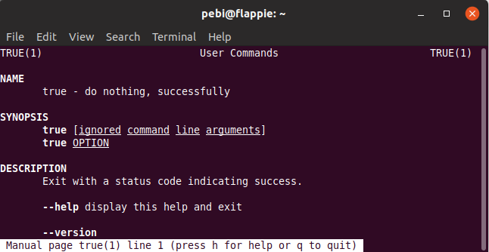

Slide 47
“Things” and lifetime
Create a window
It appears, and then disappears immediately
Lifetime starts after its line completes
Lifetime ends when its scope end is reached

Slide 48
Function calls
Add a sleep
Now the window appears and sits around
OS calls it “nonresponsive”
… well, we are sleeping, so maybe we should do something other than sleeping?

Slide 49
Demo
- Simple

Slide 50
While loop
While we should not close
  show the window

Slide 51
… maybe we can do more now?
Display some text (function call)
  Hello World!

Slide 52
Demo
- image_swap

Slide 53
If statement
If we have an argument
  Then say “Hello <person>”
  Else say “Hello World”
Sadly we only have the C-compatible main() function
  Shows pointers, which we really don’t want to

Slide 54
Creating functions
Most people now pick up & start expanding the main() function
Add new things everywhere
Extract that into functions and you have a basic demo

Slide 55
Demo
- Conway

Slide 56
What did we not need/use/teach?
Pointers
C
Creating classes
Inheritance
Virtual
Headers
Build system
Configurations
Libraries
Warning options
Licensing

Slide 57
Designing for simplicity: Simple graphics
Be powerful enough
Reduce required knowledge where possible
  Cut off edge cases
  Omit most language features
  Prefer simple over maintainable and well-designed

Slide 58
Choose one paradigm and stick with it
Arduino: Event driven
  Keeps a slight bit of magic around
Simple programs: Fully procedural
  But no obvious ways to add events
Procedural is the way the CPU works
→ We’re doing procedural. No events, no callbacks, no surprises.

Slide 59
Designing for simplicity: Simple graphics
Provide ample examples
  The best way to start is with something that works
  YOU modify it in some way
  YOU compile/run it
  It works
  and YOU changed it

Slide 60
Demo
- Colors
- Starfield

Slide 61
Designing for simplicity: Simple graphics
Make the library small and open
  Not a lot of code for a new user to read
  Accessible to any new users to read and understand
  Open for modification and change
  Any class, type, function and concept requires a new developer to learn and understand it
    Anything you leave out improves the library directly

Slide 62
Designing for simplicity: Simple graphics
Encourage users to integrate and improve the library
  Write it with simple C++ where reasonable
  Have some obvious things to fix/change
    Where the initial use is simpler without
  Make sure all users feel free and empowered to do so

Slide 63
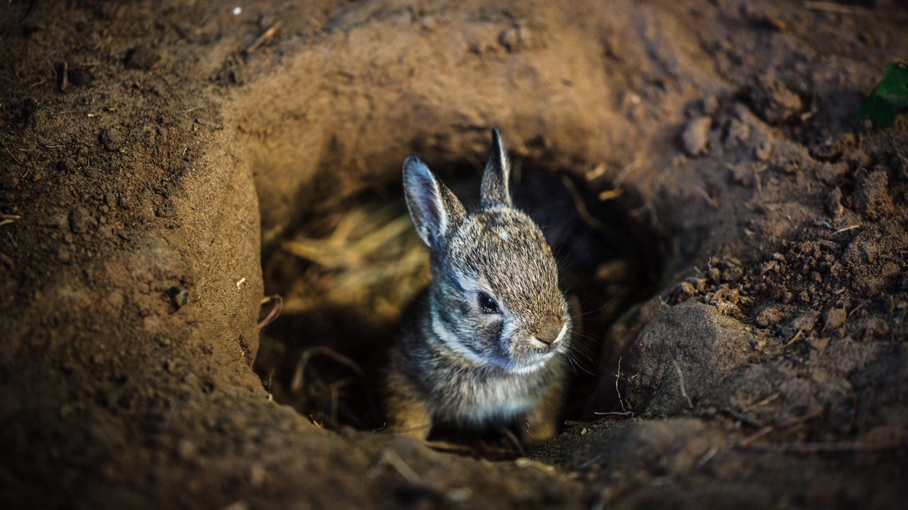

Slide 64
Complexities in a simple C++ graphics API
What backend APIs?
  OpenGL?
  Vulkan?
  Metal?
  DirectX?
  PS / XBox / Nintendo APIs?
Fully software rendering?

Slide 65
OpenGL.
Which?
  IrisGL?
  OpenGL 1.x/2.0? (immediate mode)
  OpenGL 2.x? (using buffers)
  OpenGL 3.x? (using shaders)
  OpenGL 4.5+? (with AZDO)

Slide 66
How much of OpenGL do we expose?
Buffers
Shaders
Transform feedback
Pipeline setup
Texture setup
Multi-GPU
Samplers
Vertex definition
Multi-target rendering
3D logic
Matrices
AZDO
Procedural generation
… and way more

Slide 67
What do we want from graphics?
Having some drawing surface
Changing pixel colors
Putting that on screen
Drawing some text
Loading sprites
Having sprites moving on screen
Saving drawings and screenshots
Animation?
Scaling?
Rotation?

Slide 68
Drawing text
Drawing text
  Just being able to say "Hello X" correctly
  for 95% of everybody
“Hello World” → ASCII …. or EBCDIC? Or CP437? Or Win1251?
“Witaj świecie” → Not quite ASCII anymore, but ISO8859-2. Or Win1252.
“你好，世界” → We can use GBK? Or GB2312?
“שלום עולם” → ISO8859-8. Or Win1255?

Slide 69
Drawing text
Thankfully we can put every language in Unicode.
We can always encode any valid text in UTF8
All widely used operating systems support Unicode and UTF8
  Windows has a few flags to enable it

Slide 70
Drawing text
“Hello World”
  Start on left, print character per character. Easy.
“Witaj świecie”
  Is that an accent on an ‘s’, or a different character?
  Normalization – Composed vs Decomposed
  Draw accent without cursor movement and it “works”
  Have composed characters in character set too

Slide 71
Drawing text
“你好，世界”
  Looks really hard (for me at least)
  Actually simple – draw characters in order with font.
“שלום עולם”
  Eek.
  Sdrawkcab si txet siht
  Can handle this with negative X offsets?

Slide 72
Drawing text
שלום Phil
  Completely messes up if you mix things
  Can’t work for Hebrew
  Can’t work for Arabic
Use a unicode sublibrary for the bidirectional and line-breaking algorithms

Slide 73
Drawing text
مرحبا بالعالم
م ر ح ب ا ب ا ل ع ا ل م
Can’t do it. Requires too much support.
Ȟ̸̢͑̑̽ͣͭͦ͋ͥ̎ͯͣͤͫ͂̽̊̋͂҉̷̗͍̮͙̦̹̥̖̞̤̪̱͎̥͙̀ȩ̶̰͍̑̾̓̄̎̾̓̒͑̓ͯ͋̌̍̌ͫ͐̚͝ͅľ̍ͩͩ͌҉̖̪̪̙̥͇͓̺̞͞ͅl̸̢̛̼̥̻͎̮͙̰̙̦̇ͮͬ̆ͬ̓̿ͦ̈̍͛̕̕ǒ̙͈͇̼ͧ͋̿ͭ̓͂ͬ̆̊̍͘͜ ̴̸̢͕̼̺̟ͦ̇͒́̇ͬ̎̈́ͯ̅͋̓ͪ̑͡Z̷̛̜̞̩̮̜̭̠̬̰̦͉̼͉̙̙̅̎ͬ̋̓ͦͪ̓͘͝ͅă͑ͦ͂͏͏̴̢̛̳̙̗̟lͤͭ̏̊͂ͬ̄̈ͦ̿ͤͫ͐́̓҉̧̨̤͈̤͔̙͚̞̞͕̳̲͙̘̳̩̻ͅg̴̶͕͓͕̣͉̜̭̖̳͕̙̮̫͐̃̓̒̒ͫ̽̀͠o̡̒̆ͪ̍ͣ҉͏̨̠̱̯͔̬̳̥̤͔͙͉͎̬̖̝̝
¯\_(ツ)_/¯
🤷
Technically unicode? Not losing any actual users over this.

Slide 74
Keyboard and mouse input?
Much more interactive
Non-deterministic
Much less easy to test
Way nicer demos
Can’t make games without it
Feedback loops

Slide 75
Music and sound?
Another domain required
What about just simple sound/music?
  Load simple file
  Start playing right now
  Have a handle to poll for completion

Slide 76
Demo
- Mousetrail
- Platformer

Slide 77
Conclusion (for teachers)
C++ is not a bad language to start with
It requires work to make it more accessible
Stop teaching C

Slide 78
Conclusion (for students)
C++ is a valid language to start
Watch out for going into legacy and complexity rabbit holes
Use an environment meant for beginners
Stop learning C

Slide 79
Conclusion (for committee members)
C++ is a living, breathing language
New people want to learn it
Many developers started with C++ after C++11
It requires work from you to make it more accessible
Stop C

Slide 80
Conclusion (for developers)
C++ has moved on
Stop using C and C++98
Help new people in the language
Realize how much mental load you give them and accomodate

Slide 81
Demo
- Cpponsea

Slide 82
Thank you
@dascandy42
#include discord – dascandy

